Slide 1
Introduction to Ajax
By Parul Madan
cse

Slide 2
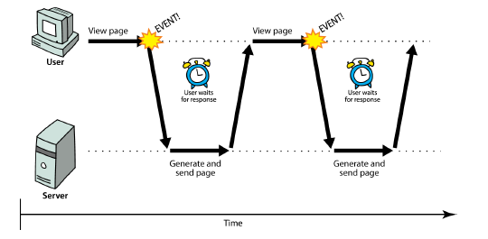
Synchronous web communication
synchronous: user must wait while new pages load
the typical communication pattern used in web pages (click, wait, refresh)

Slide 3
Web applications and Ajax
web application: a dynamic web site that mimics the feel of a desktop app
presents a continuous user experience rather than disjoint pages
examples: Gmail, Google Maps, Google Docs and Spreadsheets, Flickr, A9

Slide 4
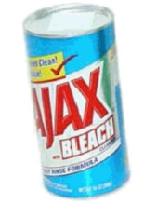
Web applications and Ajax
Ajax: Asynchronous JavaScript and XML
not a programming language; a particular way of using JavaScript
downloads data from a server in the background
allows dynamically updating a page without making the user wait
avoids the "click-wait-refresh" pattern
Example: Google Suggest

Slide 5
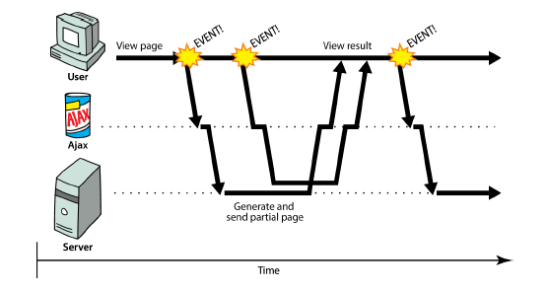
Asynchronous web communication
asynchronous: user can keep interacting with page while data loads
communication pattern made possible by Ajax

Slide 6
XMLHttpRequest (and why we won't use it)
JavaScript includes an XMLHttpRequest object that can fetch files from a web server
supported in IE5+, Safari, Firefox, Opera, Chrome, etc. (with minor compatibilities)
it can do this asynchronously (in the background, transparent to user)
the contents of the fetched file can be put into current web page using the DOM

Slide 7
XMLHttpRequest (and why we won't use it)
sounds great!...
... but it is clunky to use, and has various browser incompatibilities
Prototype provides a better wrapper for Ajax, so we will use that instead

Slide 8
A typical Ajax request
user clicks, invoking an event handler
handler's code creates an XMLHttpRequest object
XMLHttpRequest object requests page from server
server retrieves appropriate data, sends it back
XMLHttpRequest fires an event when data arrives
this is often called a callback
you can attach a handler function to this event
your callback event handler processes the data and displays it

Slide 9
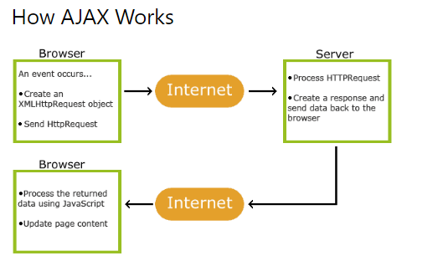
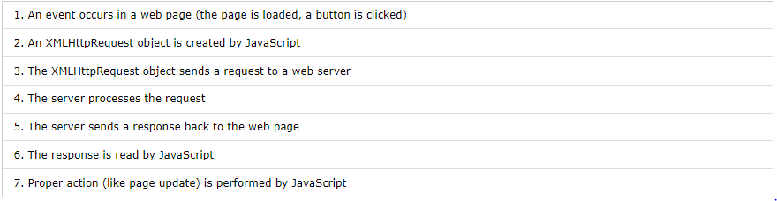
A typical Ajax request

Slide 10
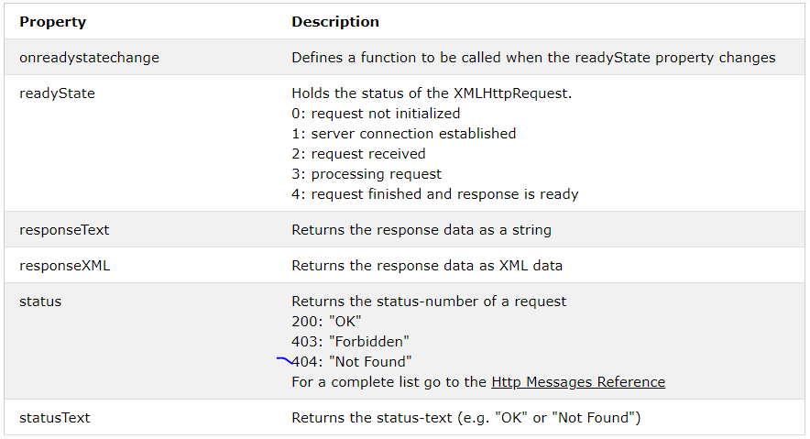
XMLHttpRequest Object Properties

Slide 11
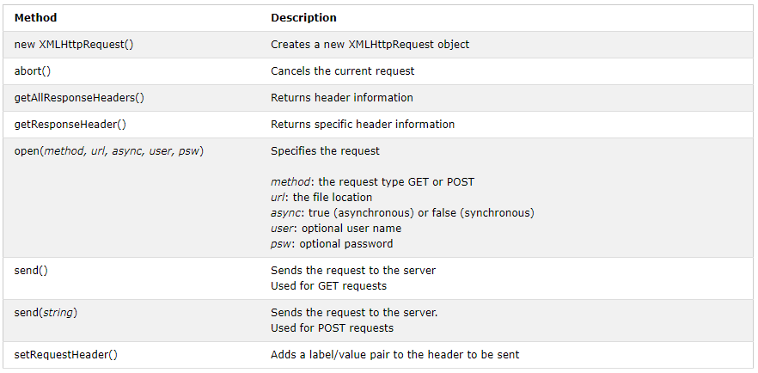
XMLHttpRequest Object Methods

Slide 12
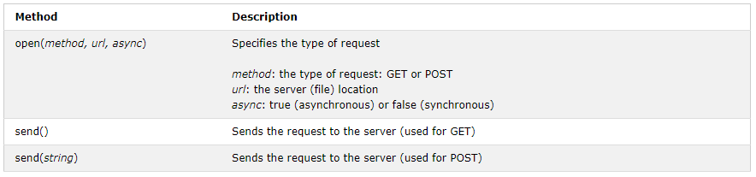
Send a Request To a Server
To send a request to a server, we use the open() and send() methods of the XMLHttpRequest object:
xhttp.open("GET", "ajax_info.txt", true); xhttp.send();
xhttp.open("GET", "demo_get2.asp?fname=Henry&lname=Ford", true); xhttp.send();

Slide 13
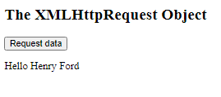
Example code:
<html>
<body>
<h2>The XMLHttpRequest Object</h2>
<button type="button" onclick="loadDoc()">Request data</button>
<p id="demo"></p>
<script>
function loadDoc() {
var xhttp = new XMLHttpRequest();
xhttp.onreadystatechange = function() {
if (this.readyState == 4 && this.status == 200) {
document.getElementById("demo").innerHTML = this.responseText;
}
};
xhttp.open("GET", "demo_get2.asp?fname=Henry&lname=Ford", true);
xhttp.send();
}
</script>
</body>
</html>

Slide 14
Prototype's Ajax model
new Ajax.Request("url",
{
option : value,
option : value,
...
option : value
}
); JS
construct a Prototype Ajax.Request object to request a page from a server using Ajax
constructor accepts 2 parameters:
the URL to 1. fetch, as a String,
a set of options, as an array of key : value pairs in {} braces (an anonymous JS object)
Notes:
2.
hides icky details from the raw XMLHttpRequest; works well in all browsers

Slide 15
Prototype Ajax methods and properties
option | description
method | how to fetch the request from the server (default "post")
parameters | query parameters to pass to the server, if any
asynchronous (default true), contentType, encoding, requestHeaders
options that can be passed to the Ajax.Request constructor

Slide 16
Prototype Ajax methods and properties
event | description
onSuccess | request completed successfully
onFailure | request was unsuccessful
onException | request has a syntax error, security error, etc.
events in the Ajax.Request object that you can handle

Slide 17
Basic Prototype Ajax template
property | description
status | the request's HTTP error code (200 = OK, etc.)
statusText | HTTP error code text
responseText | the entire text of the fetched page, as a String
responseXML | the entire contents of the fetched page, as an XML DOM tree (seen later)
function handleRequest(ajax) {
alert(ajax.responseText);
} JS

Slide 18
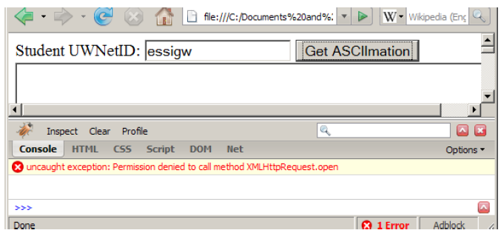
XMLHttpRequest security restrictions
cannot be run from a web page stored on your hard drive
can only be run on a web page stored on a web server
can only fetch files from the same site that the page is on www.foo.com/a/b/c.html can only fetch from www.foo.com

Slide 19
Handling Ajax errors
new Ajax.Request("url",
{
method: "get",
onSuccess: functionName,
onFailure: ajaxFailure,
onException: ajaxFailure
}
);
...
function ajaxFailure(ajax, exception) {
alert("Error making Ajax request:" + "\n\nServer status:\n" + ajax.status + " " + ajax.statusText +
"\n\nServer response text:\n" + ajax.responseText);
if (exception) {
throw exception;
}
} JS
for user's (and developer's) benefit, show an error message if a request fails
Notes:
for user's (and developer's) benefit, show an error message if a request fails

Slide 20
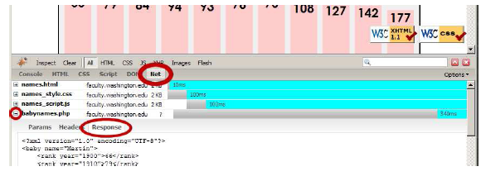
Debugging Ajax code
Net tab shows each request, its parameters, response, any errors
expand a request with + and look at Response tab to see Ajax result

Slide 21
Creating a POST request
new Ajax.Request("url",
{
method: "post", // optional
parameters: { name: value, name: value, ..., name: value },
onSuccess: functionName,
onFailure: functionName,
onException: functionName
}
); JS
Notes:
http://www.tizag.com/ajaxTutorial/index.php

Slide 22
Creating a POST request
Ajax.Request can also be used to post data to a web server
method should be changed to "post" (or omitted; post is default)
any query parameters should be passed as a parameters parameter
written between {} braces as a set of name : value pairs (another anonymous object)
get request parameters can also be passed this way, if you like

Slide 23
Prototype's Ajax Updater
new Ajax.Updater(
"id",
"url",
{
method: "get"
}
); JS
Ajax.Updater fetches a file and injects its content into an element as innerHTML
additional (1st) parameter specifies the id of element to inject into

Slide 24
CODE:

